Slide 1
Powershell Remoting
Chapter 3

Slide 2
Topics
WSMan
WINRM
PsSession

Slide 3
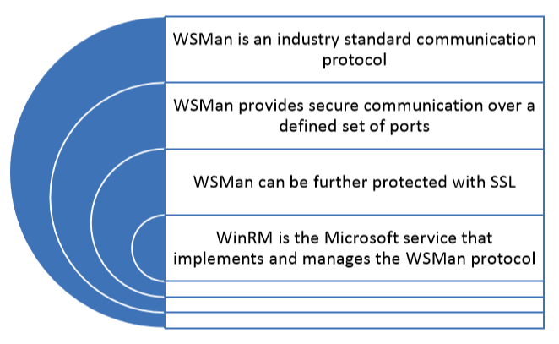
Understand WSMan and WinRM

Slide 4
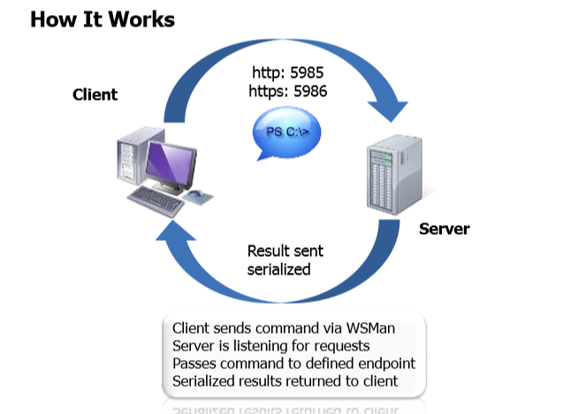

Slide 5
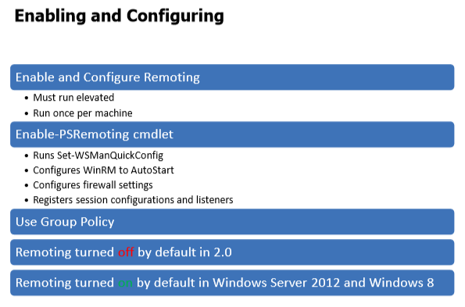

Slide 6
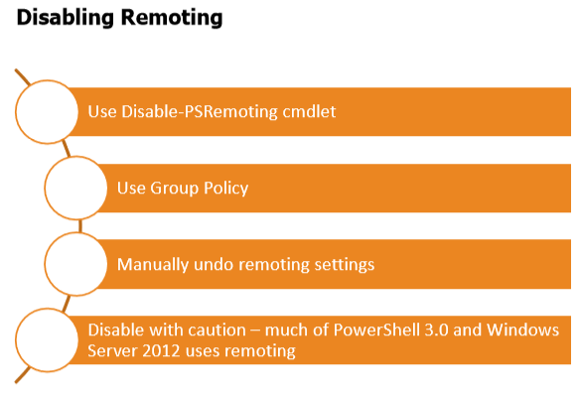

Slide 7
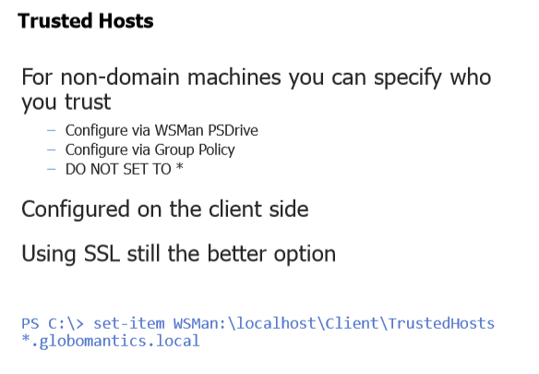

Slide 8
PsSession
Created for remote machines
Can specify alternate credentials
Can specify authentication
Can specify SSL

Slide 9
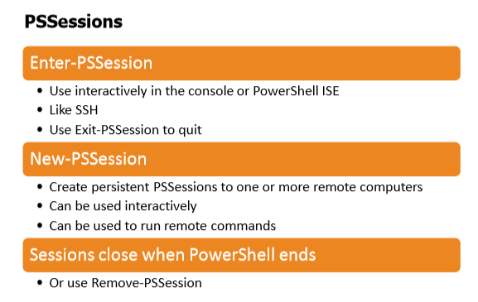

Slide 10
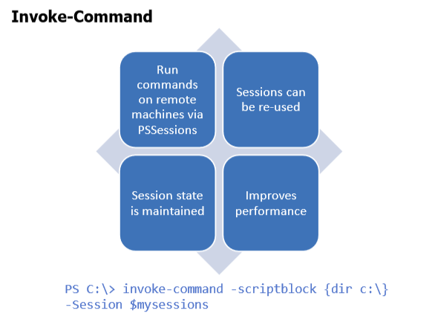

Slide 11
